Slide 1
SUICIDE AND OTHER PSYCHIATRIC EMERGENCIES
OPIO JOEL
G COHES

Slide 2
PSYCHIATRIC EMERGENCY
Is an acute disturbance of behavior, thought or mood of a patient which if untreated may lead to harm, either to the individual or to others in the environment.

Slide 3
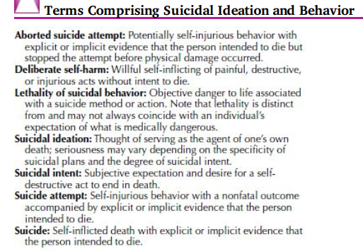
Introduction-

Slide 4
Men commit suicide 3x more than women
Women attempt suicide 4x more than men
Men use more violent methods
Except for the 15-24 age group suicide increases with age: Men peak after 45; women after 55. For men >65: incidence of 40/100,000
Elderly account for 25 % of suicides and only 10% of population

Slide 5
Rates
Religion: suicide rates among Catholic populations are lower than the rates among Protestants and Jews (orthodoxy probably more important than religion)
Marital Status: marriage with children greatly less
single, never-married have double the rate for married

Slide 6
Marital status (cont.)
Previously married much higher than single:
24/100,000 among widowed
40/100,000 among divorced
69/100,000 among divorced males; 18 for women
Occupation
higher the social status, higher the risk
a fall from social status increases the risk
work protects

Slide 7
Rates (cont.)
Occupation (cont.)
Female physicians have highest rate: 41/100,000
Male physicians no increase
Psychiatrists>ophthalmologists>anesthe-siologists
Other: dentists, musicians, law enforcement officers, lawyers, and insurance agents

Slide 8
Rates (cont.)
Physical health: strong relationship with suicide: postmortem studies show 25-75% of all suicide victims have some physical illness. Health is contributing factor in 11-51%
Mental health:
almost 95% of all patients who commit or attempt suicide have a diagnosed mental disorder.

Slide 9
Rates (cont)
Mental Health (cont.)
80%depression, 10% psychotic disorders, dementia 5%
Risk in mood disorders:15%
Risk in alcoholism: 15%
also significant in panic disorder and OC disorder

Slide 10
35-80% of all suicidal behavior is alcohol-related

Slide 11
Psychiatric disorders and suicide(90-95%)
Depression: 50-70%
Schizophrenia: 10-15%
Alcohol/Drug dependence: 15-25%

Slide 12
Causes of Suicide
Genetic
Parental separation or death before child is 15 years
Chronic Physical illness e.g AIDS
Psychiatric disorder: Mainly “DAS”: Depression, Alcoholism and Schizophrenia
As a result of political zeal, religious fanaticism, terrorist organization or affiliation.
Loss of face or respect
Problems in interpersonal relationships, love affairs…
General economic difficulty

Slide 13
Motivation in Suicide Behaviour
End personal problems
A means to peace, rest and comfort
Punish enemies and uncaring relatives
Satisfy enemies and unburden relatives
Join the dead beloved relatives
Punish oneself (for personal sin)
Intense psychic pain (Sadness and distress)
Process of “GROWTH” and Dev’t (Re-incarnation)
Cry for help

Slide 14
Risk Factors
Relationship Problems
Experience with Firearms
Alcohol Abuse
Unexplained Mood Changes or Depressed Mood
Male

Slide 15
Risk Factors (cont.)
Previous suicidal behavior
h/o psychiatric d/o
Personality disorder
Unexpected physical disability
FH:
unstable childhood/adolescence
abuse, neglect, rejection by parent
close relationship to someone who committed suicide

Slide 16
Warning Signs
Suicidal Talk “I Wish I Were Dead” “If ........Happens, I’ll Kill Myself” “No One Cares About Me” “I Just Want All Of This To End”

Slide 17
Warning Signs
Suicide Preparation
Notes
Giving Away Personal Possessions
Final Arrangements
Preoccupation with Death
Prior Suicide Gestures or Attempts
Social Withdrawal
Mood Changes

Slide 18
Suicide Assessment
Thorough psychiatric evaluation (hx, MSE)
Including suicidal thinking and evaluation
Identify risk factors, with emphasis on modifiable ones
Asses immediate safety and decide on appropriate setting for rx
Determine dx to guide rx
Suicide assessment scales may be used as aids to suicide assessment but should not be used as predictive instruments or as substitutes for a thorough clinical evaluation

Slide 19
Specific qtns focusing on suicide
Be aware of cultural and religious beliefs/context
1. Suicidal ideation
nature, frequency, timing, persistence
2. If ideation is present enquire about plan
Steps taken to enact plans or prepare for death
Expected lethality of preferred method
3. If +ve hx of suicide attempts, aborted attempts, or other self-harming behavior
Timing, intent, method, and consequences of such behaviors
Life context- eg intoxication

Slide 20
CLINICAL ASSESSMENT (con’t)
Should include a FULL:
History
Physical examination
Mental state examination
Assessment of suicide risk

Slide 21
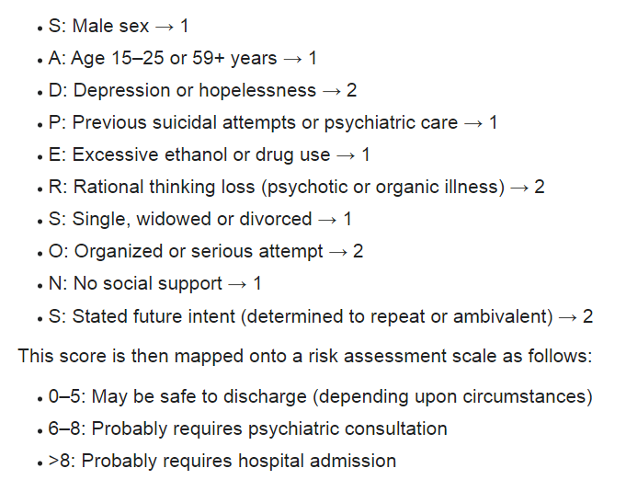
Modified SADPERSONS scale

Slide 22
Assessment (cont.)
Assess aforementioned risk factors
If they have a plan:
P - what is the proximity to help?
A - what is the availability of means?
L - what is the lethality of means?
S - what is the specificity of the plan?

Slide 23
Assessment (cont.)
Assess information provided by others:
available support
job stressors
impulsive behavior
safety of where pt will spend next 48 hours
attitudes of family, friends, and command
availability of chaplain, etc..

Slide 24
Treatment- general principles
Applies to those with suicidal thoughts, plans, attempts
Determine a setting for rx and supervision
May include involuntary admission, intensive outpatient care, less intense outpatient care
Choice for rx setting based on
Dr’s estimate of the patient’s current suicide risk
Potential for dangerousness to others
Medical and psychiatric comorbidity
Strength and availability of a psychosocial support network
Ability to provide adequate self-care
Give reliable feedback to the dr, and cooperate with treatment
Choice of intensive interventions may need to be weighed against their possible negative effects

Slide 25
Treatment- general principles
Attend to patient safety (caution card*)
Establish a solid dr-pt relationship

Slide 26
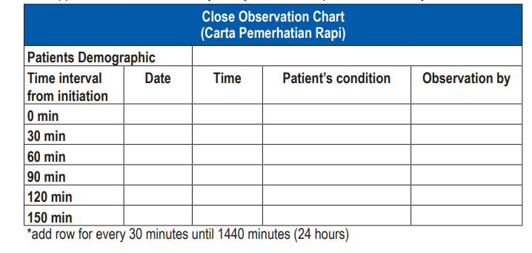
Example

Slide 27
Specific rx modalities
Targeting thoughts and behaviors
Address modifiable risk factors and continuously evaluate these
Treat underlying d/o if present
Psychosocial interventions
Improvements in interpersonal relationships read about interpersonal psychotherapy
Coping skills- read about coping enhancement
Rectify distorted thinking patterns- read about cognitive behavioral therapy
Empower to solve present problems- read about problem solving therapy

Slide 28
Specific rx modalities
Pharmacological interventions
Antidepressants
Evidence for lowering suicide rates is inconclusive
More evidence present for mx of depression
Select one with low risk of lethality on acute overdose
Prescribe conservative quantities
Patients need to be educated on the possibility of delayed sx relief
Other agents that may be indicated
Benzodiazepines
Lithium if mood stabilizer is indicated
ECT in the context of depression

Slide 29
Suicide contracts/No harm contract
Is not a legal document
Can be verbal or written
Can be helpful for assessing degree of therapeutic alliance
Not recommended in
Emmergency settings
Newly admitted patients
Agitated, psychotic, severely ill
You need to be fully aware of the limitations of the contract
False assurance, no licence to get your guard down

Slide 30
Example
“We (clinician and patient) agree that you (patient) will call me if you find that you are worrying about harming yourself. If you feel you need immediate help and cannot reach me at that moment, you will go directly to the emergency room (specifically designated). If you need to be seen between appointments, I will be available to see you.”

Slide 31
Surviving suicide
Toll on suicide survivors appears greater than that by other deaths
opportunities for guilt are so great
In the immediate aftermath relatives are at increased risk for psychological and physical ill health
Should thus be supported adequately
May include clinicians who have lost patients to suicide
May also suffer loss of professional self esteem

Slide 32
OTHER PSYCHIATRIC EMERGENCIES
Agitated and violent patients
Signs predicting an impending assault are
anger,
demanding immediate attention,
loud voice,
excitement,
staring eyes,
flared nostrils,

Slide 33
flushed face,
hands clenched or gripping,
pacing about in the room,
possessing weapons,
pushing furniture,
uncooperativeness and suspiciousness,
slamming objects
sudden movements

Slide 34
Management
Sedation
-haloperidol 10mg im q30min, max=60mg
-iv lorazepam 2mg, max =10mg; Preferred if alcohol withdrawal is suspected
physical examination and laboratory
studies to exclude the common causes
violent behavior

Slide 35
An altered state of consciousness, consisting of confusion, distractibility, disorientation, disordered thinking and memory, defective perception (illusions and hallucinations), prominent hyperactivity, agitation and autonomic nervous system overactivity
Mgt: environmental manipulation to orient the patient (eg. leaving a light on at night, frequent orientation to time, place, and person)
_{Drugs} only after the underlying disorder has been diagnosed or the process of determining the dx has been initiated
DOC: Haloperidol-low doses (0.5 to 2 mg)
Lorazepam 0.5 to 2 mg preferred in substance intoxication

Slide 36
Substance intoxication and withdrawal
Alcohol, cocaine and phencyclidine are the substances that most commonly lead to violent behaviour
Lorazepam 2 to 4 mg stat or
diazepam 10 to 20 mg stat
Delirium tremens- withdrawal syndrome that usually occurs 24 to 72 h
Rx: high doses of benzodiazepines, parenteral thiamine and maintenance of fluid and electrolyte balance.

Slide 37
Neuroleptic malignant syndrome
Characteristic signs are muscle rigidity, hyperpyrexia, tachycardia, hypertension, tachypnea, change in mental status and autonomic dysfunction
Lab dx:
respiratory and metabolic acidosis,
myoglobinuria, elevated CK and leucocytosis
Rx: bromocriptine 2.5 to 20 mg tid or dantrolene up
to 10 mg/kg IV q 4 h

Slide 38
Serotonin syndrome
Mainly caused due to combining MAOIs and SSRIs
hyperthermia, diaphoresis, excitement or confusion, hyperreflexia, hypotension, tremor. May progress to DIC, rhabdomyolysis and cardiovascular collapse…….>>> DEATH!!!
Rx:
dantrolene,
periactin, a serotonin antagonist

Slide 39
Delirium
This is a form of excitement in which the patient acts out of context to reality and may experience hallucinations.
Causes: organic brain disorders, influence of drugs, head trauma, severe infections like fever…
Rx: Manage cause.

Slide 40
Delirium Tremens
An acute confusional state often seen as a withdrawal syndrome in chronic alcoholics and caused by sudden cessation of drinking alcohol.
Features: anxiety, tremor, sweating and vivid terifying visual and sensory hallucinations, “pink elephants”.
Without Rx, severe cases may end fatally.
Rx:

Slide 41
Alcoholic Hallucinosis
The patient is in greater danger here because his hallucinations usually take the form of accusations against people around him and threats to his own safety. These may lead him to suicide or homicide.
The patient should be placed in a psychiatric hospital.

Slide 42
Alcoholic intoxication
Pale
Cold sweat
Vomiting
>>>Unconsciousnes!!!
This alcohol stupor may disappear as metabolism takes place, but if concentration of alcohol within body fluids is too high, death results.

Slide 43
Alcohol intoxication (con’t)
Mgt
Empty patient’s stomach by helping him to vomit. Drinks 2 -3 glasses of warm salt water
Keep patient’s body warm (An intoxicate person easily chills and develops pneumonia)
Give a mixture of 1 teaspoonful of aromatic spirit of ammonia in a glass of water. This stimulant relieves depressant effects of alcohol.
SEDATIVES SHOULD NEVER BE GIVEN

Slide 44
Overdose of prescribed psychoactive drugs
If the patient has taken a toxic dose and is awake, treatment consists of inducing emesis followed by administering activated charcoal.
Overdose with tricyclic antidepressants or carbamazepine -cardiac monitoring.
Overdose with barbiturates or benzodiazepines and alcohol -respiratory arrest.
Antipsychotic drugs: adverse effects including dystonia, oculogyric crisis, torticollis, and akinesia, Akathisia: Immediate relief may be provided with a parenteral antihistaminic such as promethazine 25 mg IM.

Slide 45
Acute Psychosis
Patients having this affliction lose contact with reality, often becoming violently aggressive and attempting assault or homicide.
What to do:
The patient should be placed in a psychiatric hospital and kept under constant supervision
All weapons and objects that might harm should be removed from his room.
As far as feasible, physical restraint should be avoided in favour of firm supervision.
Manage the exact etiology.

Slide 46
Hysteria
In this functional disorder the patient conducts himself in a strange manner, usually with intense emotion, because of some unsolved personality problem.
Hysteria may imitate almost any disease, including mental disorder.
Immediate care of the patient requires a combination of firmness and kindness.

Slide 47
THE END
THANK YOU

